Slide 1
COMP 7212: Operating/Distributed Systems
Chapter 6: Coordination
Dr. Myounggyu Won
“In this chapter, we concentrate on how processes synchronize and coordinate with one another.”
Reference: Distributed Systems: Principles and Paradigms (3rd Edition)

Slide 2
Outline
Clock synchronization
  Physical clocks
  Clock synchronization algorithms
Logical clocks
  Lamport’s logical clocks
  Vector clocks
Mutual exclusion
  Overview
  A centralized algorithm
  A distributed algorithm
  A token-ring algorithm
  A decentralized algorithm
Election algorithms
  The bully algorithm
  A ring algorithm
  Elections in wireless environments
Location systems
  GPS

Slide 3
Clock Synchronization
“How to achieve agreement on time?”

Slide 4
Physical Clocks
A computer system has a clock/timer used to keep track of time.
In a single computer system, it does not matter much if the clock is off by a small amount since all processes are on the same machine.
As soon as multiple CPUs (i.e., multiple nodes) are introduced with its own clock, the situation is different.
  Each node’s notion of time may differ from the ground-truth clock value.
  This difference in time is called clock skew.
Challenges
  How do we synchronize with the real-world clock (ground-truth clock value)?
  How do we synchronize the clocks with each other?

Slide 5


Clock Synchronization Algorithms (1/7)
If one node has a Universal Coordinated Time (UTC) receiver (i.e., synchronized with the real-world clock), the goal is to keep all the other nodes synchronized to it.
Let C_{p}(t) denote the clock value of node p at the UTC time t; the goal is to keep the deviation between any two nodes, called precision, within a specific bound, π
The accuracy is the difference between the clock value of node p and the external reference point (e.g., UTC); the goal is to keep the accuracy bound to a value α

Slide 6
Clock Synchronization Algorithms (2/7)
The frequency of hardware clocks is affected by external sources such as temperature, noise, interference, and voltage fluctuations, etc.
The clock value gradually becomes different from the UTC time.
The difference per unit time from the UTC time is called the clock drift rate

Slide 7
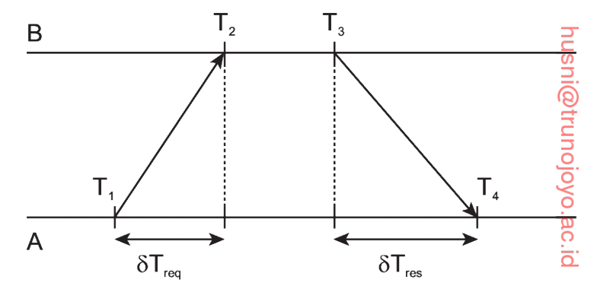
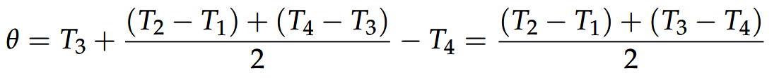
Clock Synchronization Algorithms (3/7)
Network time protocol (NTP)
  The idea is to let clients contact a time server and synchronize with the time of the time server
  A problem is the message delay that will outdate the reported time
  A trick is to estimate these delays and incorporate them in calculating the time difference between the client and the server.
  The estimated offset relative to B (time difference between A and B) is:
Time difference without considering the delay
(T4 – T1) – (T3 – T2)
Propagation delay between A and B

Slide 8
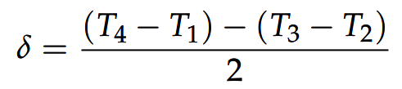
Clock Synchronization Algorithms (4/7)
Network time protocol cont.
  In NTP, the offset θ is computed along with the estimated delay δ:
  Eight pair of (θ, δ) are buffered.
  The offset θ associated with the smallest δ is selected as the best estimation.
  To prevent adjusting a clock known to be accurate, NTP divides servers into different categories.
    For example, the server with a reference clock such as a UTC receiver is a stratum-1 server. (lowest stratum level = highest accuracy)
    When A contacts B, it will adjust its clock only if its stratum level is higher than that of B.
    Moreover, after synchronization, A’s stratum level will become one higher than that of B.

Slide 9
Clock Synchronization Algorithms (5/7)
The Berkeley algorithm
  In many clock synchronization algorithms, the time server is passive (simply responds to queries).
  In the Berkeley algorithm, the time server is active, polling every machine from time to time to ask what time it is there.
  An average time is computed; based on that, asks other machines to advance their clocks or slow their clocks
  This algorithm is suitable for a system in which no machine has a UTC receiver.
    Since we do not have the UTC time, we use the average instead.

Slide 10
Clock Synchronization Algorithms (6/7)
Clock synchronization in wireless networks
  In traditional distributed systems, most machines can contact each other.
  This assumption is no longer valid in wireless networks
  Reference broadcast synchronization (RBS)
    There is no node with an accurate account of actual time.
    The goal is not to synchronize the clocks with UTC, but rather to synchronize the clocks with one another.

Slide 11
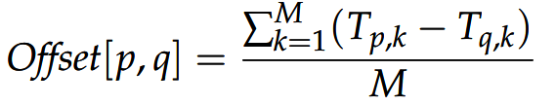
Clock Synchronization Algorithms (7/7)
Reference broadcast system (RBS) cont.
  A designated node called the reference broadcaster broadcasts a reference message that allows its receivers to adjust their clocks.
  When a node q broadcasts a reference message m, each node p, simply records the time T_{p,m} (p’s local time) when it received m.
  The offset is then calculated as the average for M messages

Slide 12
Logical Clocks
“What usually matters is not that all processes agree on exactly what time it is,
but rather that they agree on the order in which events occur.”

Slide 13
Lamport’s Logical Clocks (1/2)
To synchronize logical clocks based on the order of events, a relation called the happens-before relation needs to be defined.
  a->b is read “event a happens before event b.”
The happens-before relation is a transitive relation
  a->b and b->c, then a->c
If two events x and y happen in different processes that do not exchange messages, then x->y is not true, neither y->x
For each event a, we can assign a time value C(a)
  If a->b, then C(a) < C(b)

Slide 14
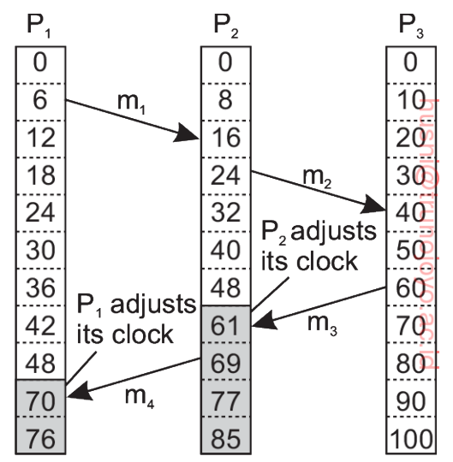
Lamport’s Logical Clocks (2/2)
Consider an example with three processes (P1’s timer is incremented by 6 units, P2’s timer by 8 units, and P3’s timer by 10 units)
  The event of sending m3 by P3 happens before the event of receiving m3 by P2; thus, the timer value for P2 should be adjusted.

Slide 15
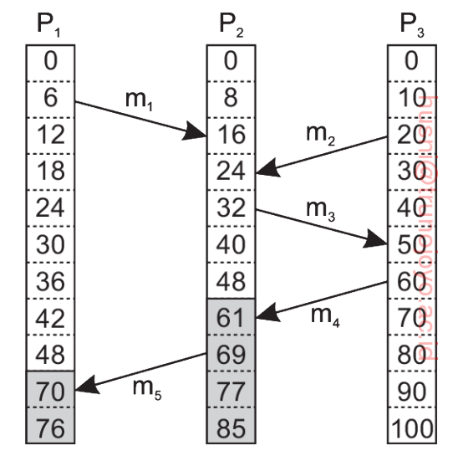
Vector Clocks (1/4)
With Lamport’s logical clocks, C(a) < C(b) does not necessarily mean that event a indeed happened before event b
  No causality between the two events.
The sending of m2 (20) has
nothing to do with
the receipt of m1 (16);
We cannot say that m1
happened before m2 even
if C(m1) < C(m2).

Slide 16
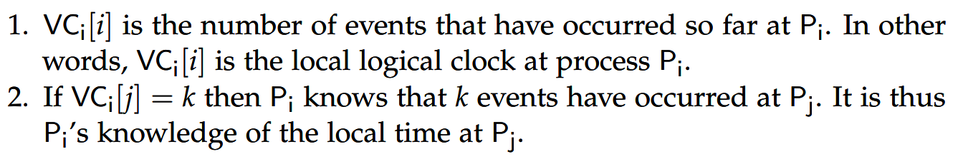
Vector Clocks (2/4)
Causality is captured by means of vector clocks.
  A vector of local clocks of all processes
  e.g., VC₁ = (1,3,3)
A vector clock of process P_{i} is denoted by VC_{i} which has the following two properties:

Slide 17
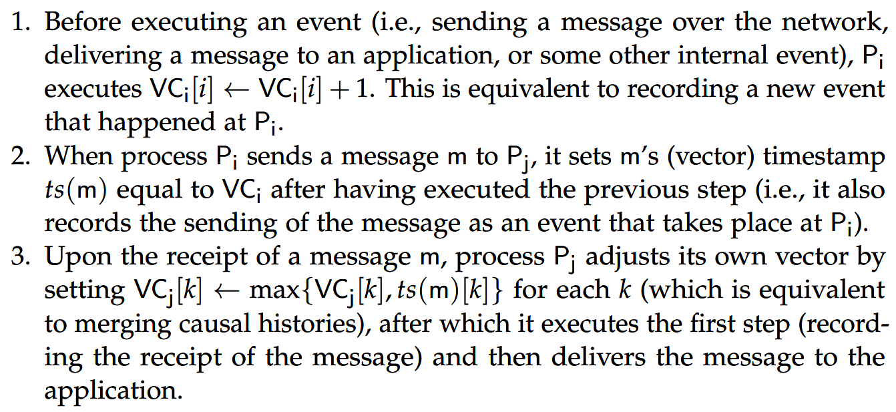
Vector Clocks (3/4)
In particular, the following is performed to synchronize the logical clocks:
i.e., after increasing its local clock value by 1

Slide 18
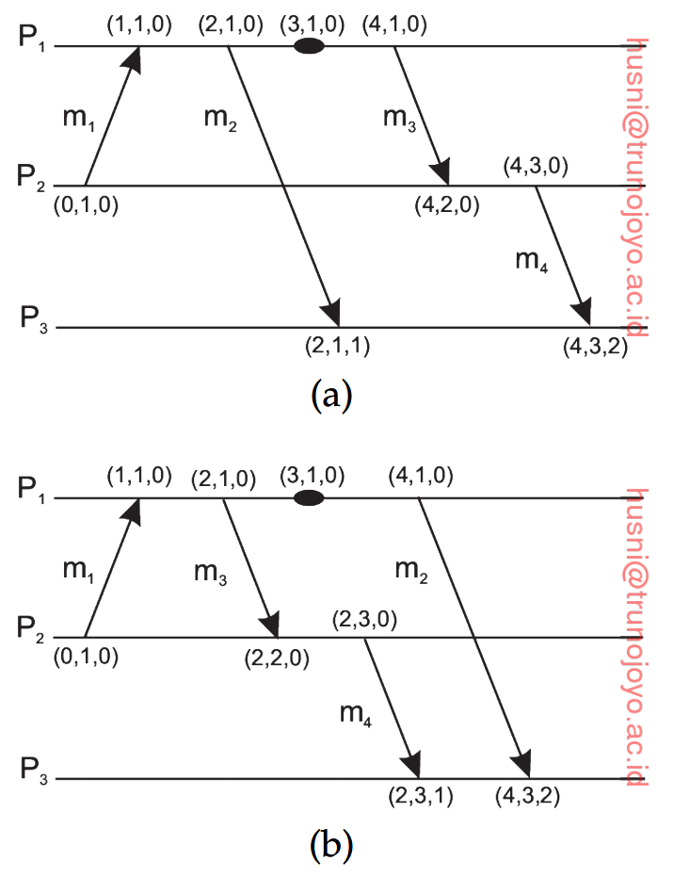
Vector Clocks (4/4)

Slide 19
Mutual Exclusion
“The concurrent access of processes to a resource can make it inconsistent.
Solutions are needed to grant mutually exclusive access.”
HELLOWORLD vs HEWLOLROLD

Slide 20
Overview
Two categories of distributed mutual exclusion algorithms
  Token-based solutions
    Mutual exclusion is achieved by passing a special message between processes, known as a token.
    Only one token is available and whoever has that token is allowed to access the shared resource.
    What if a token is lost?
  Permission-based approaches
    A process wanting to access the resource first requires the permission from other processes.
    How to grant such a permission?

Slide 21
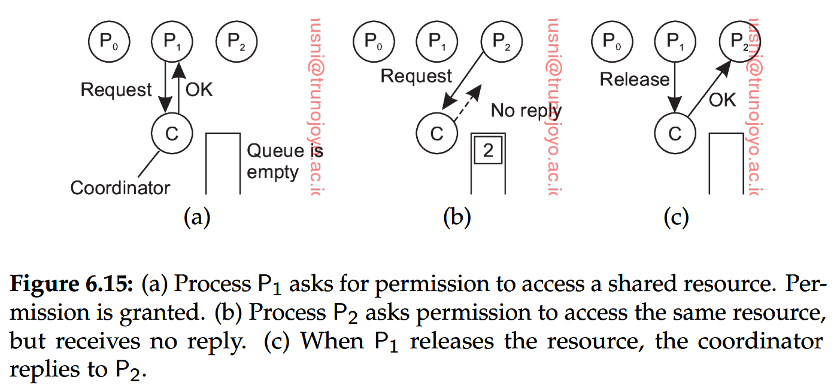
Centralized Algorithm (Permission-Based)
Benefits
  Guarantees mutual exclusion, easy to implement
  No starvation (i.e., no process remains unable to access the shared resource indefinitely) because requesting processes are queued according to the order of request
Shortcomings
  A single point of failure, bottleneck

Slide 22
Distributed Algorithm (Permission-Based) (1/3)
When a process wants to access a resource, it builds a message with the name of resource, its process number, and the logical time.
It then sends the message to all other processes.
This algorithm requires a total ordering of all events (e.g., based on vector clocks).
  For any pair of events, it must be unambiguous which one happened first.

Slide 23
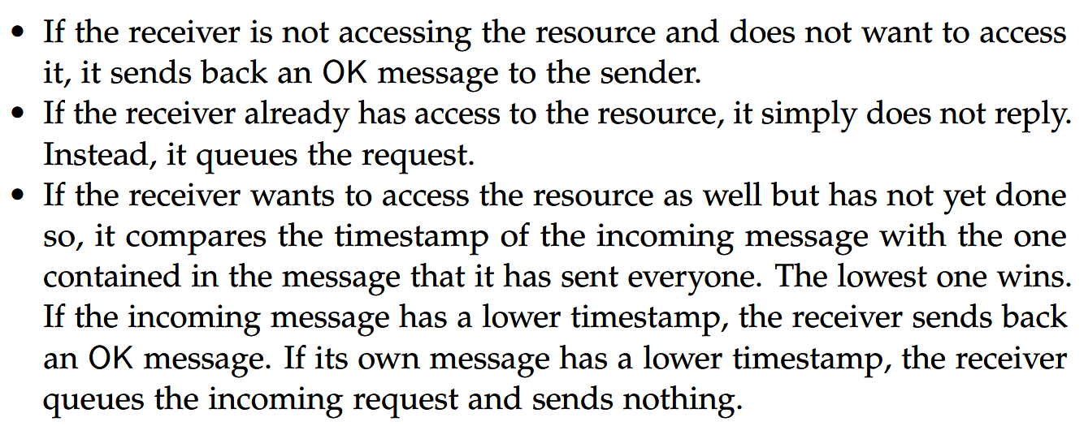
Distributed Algorithm (Permission-Based) (2/3)
When a process receives a request message, there are three different cases:

Slide 24
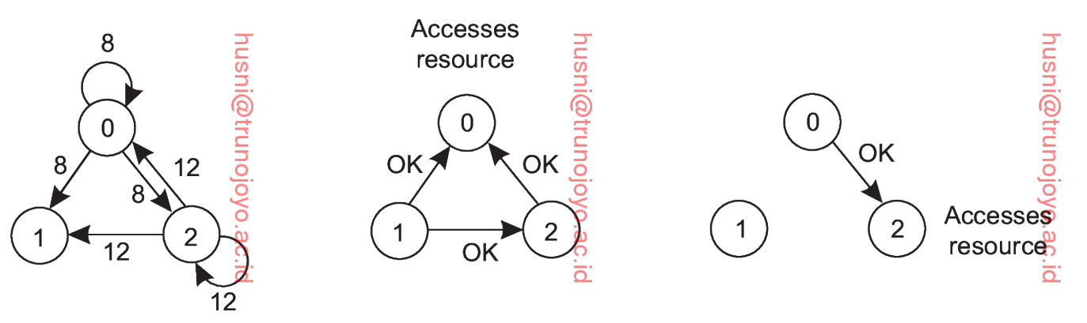
A Distributed Algorithm (Permission-Based) (3/3)
Timestamp
P0 is done and sends OK to P2
P0 with lower
timestamp wins!
Node 1 does not want to access the shared resource

Slide 25
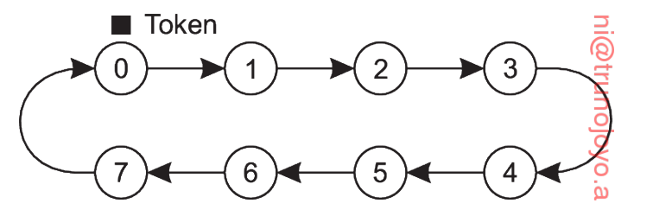
A Token-Ring Algorithm (1/2)
Construct an overlay network in the form of a logical ring.
P₀ is given a token, and the token circulates around the ring.
When acquired a token, the process checks to see if it needs to access the shared resource.
After finished, it passes the token along the ring

Slide 26
A Token-Ring Algorithm (2/2)
What if a token is lost?
  Maybe we can regenerate it, but it maybe possible that someone is holding the token for a long time.
  Q?
What if a process crashes?
  The ring topology is broken.
  This problem is relatively easier than losing a token.
    The crashed process can be removed from the group.

Slide 27
Election Algorithms
“We will look at algorithms for electing a coordinator.”

Slide 28
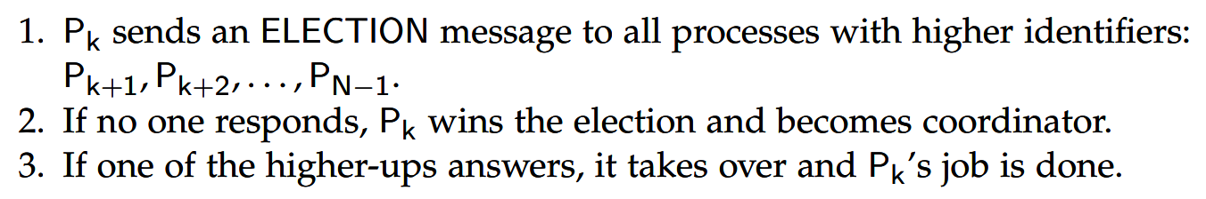
The Bully Algorithm
Consider N processes {P₀, …, P_{N-1}} and let id(P_{k}) = k
A process P_{k} holds an election as follows.
The one who took over then holds an election.
Eventually, all processes give up but one which is the new coordinator.

Slide 29
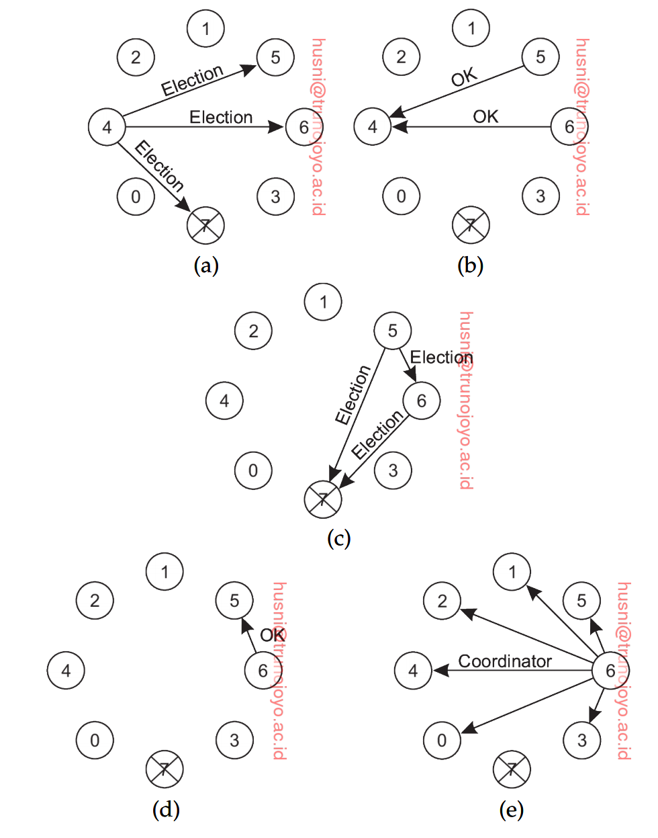
The Bully Algorithm
Nodes 5 and 6 reply.
Node 4 stops sending the ELECTION message.
Nodes 5 and 6 send the ELECTION message to nodes with greater IDs
Example
Node 4 initiates the election process.
Node 7 does not reply.
Node 5 receives reply from Node 6.
Thus, it stops.
Node 6 receives no reply.
Thus, it becomes the leader.

Slide 30
A Ring Algorithm
An election algorithm based on a ring topology.
When any process notices that the coordinator is not functioning (i.e., need to elect a new leader), it builds an ELECTION message containing its identifier and sends it along the ring.
When the message gets back, the process with the highest identifier is found.
The initiator then circulates a COORDINATOR message to inform everyone else who the coordinator is.

Slide 31
Elections in Wireless Environments (1/2)
We assumed that message passing is reliable, and the topology does not change.
  This assumption does not work in wireless environments.
Vasduevan et al.’s solution
  Any node initiates by sending an ELECTION message to its immediate neighbors.
  When a node receives this message, it designates the sender as its parent and sends the message to its immediate neighbors.
  When a node receives an ELECTION message from a node other than its parent, it simply acknowledges the receipt.
  If all neighbors already have a parent, i.e., a leaf node, it will report back its capacity (assuming that the capacity is used as a main metric for electing the leader).
  A node receiving the report, will compare the reports from its immediate neighbors and report back the node with the highest capacity.
  An initiator will then be able to find the one with the highest capacity.

Slide 32
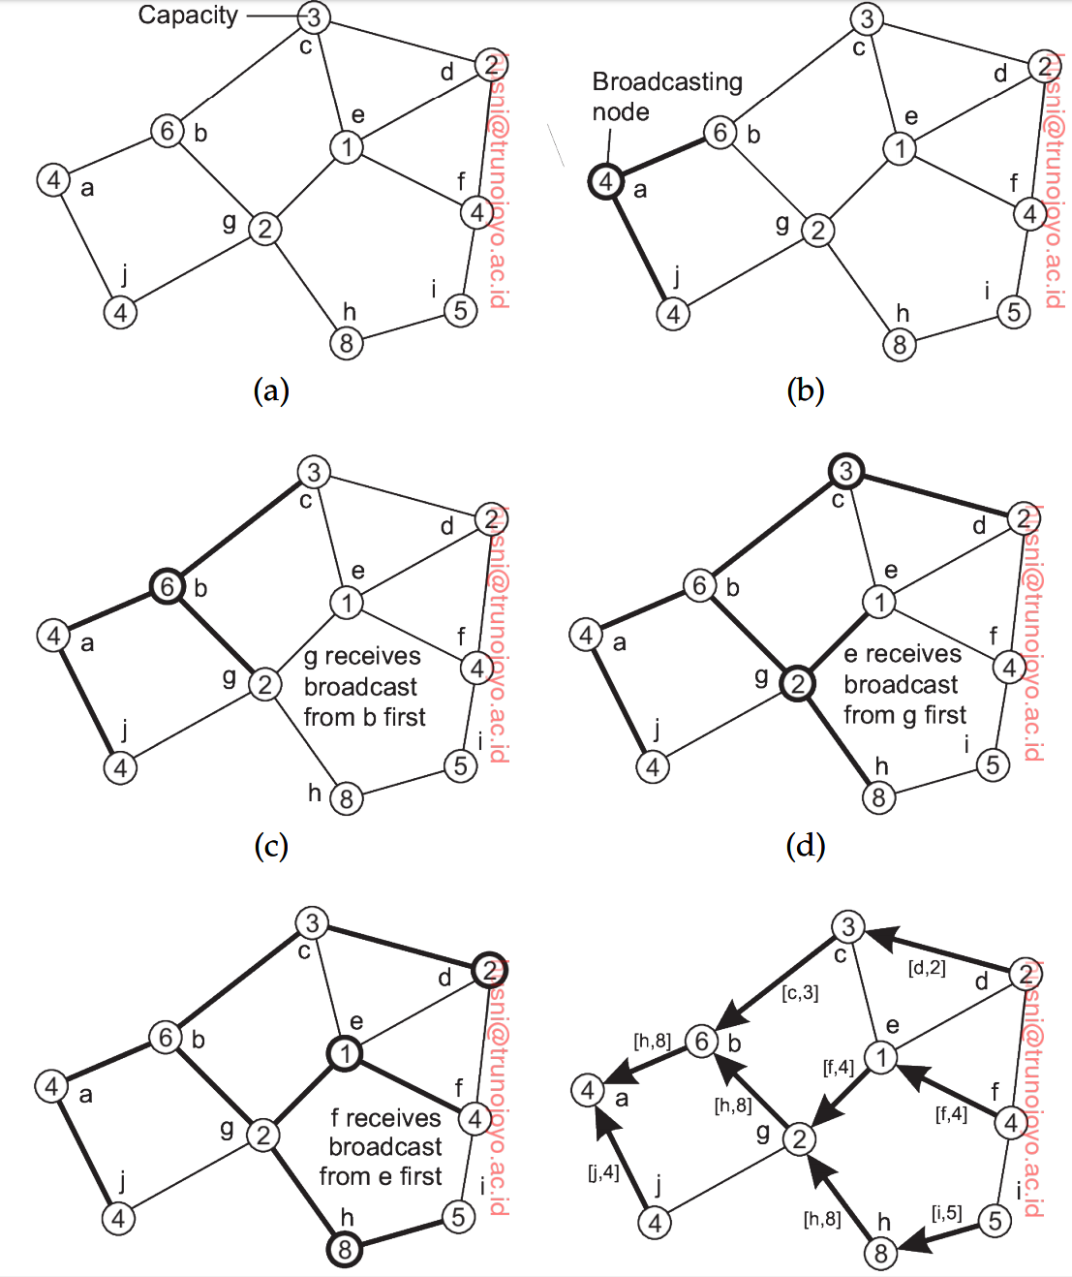
Elections in Wireless Environments (2/2)

Slide 33
Location Systems

Slide 34
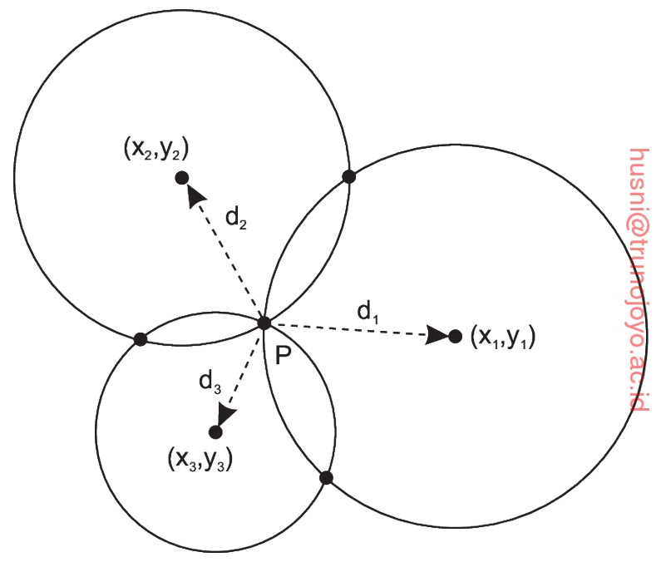
GPS: Global Positioning System
The positioning problem is simply solved through the Global Positioning System (GPS)
A satellite continuously broadcasts its position and time, which allows a receiver on Earth to compute its own position
An example for a two-dimensional space
  Can be easily extended for a 3D space
  In 3D positioning, such as GPS, at least four satellite measurements are generally needed because the receiver must also estimate its clock offset.

Slide 35
GPS: Global Positioning System
When GPS is not an option
  A major drawback of GPS is that it does not work indoors
  A possible solution is to use Wi-Fi access points (like satellites)
    There are numerous Wi-Fi-based indoor localization techniques
    Let’s read state-of-the-art papers on indoor positioning systems

